Slide 1

IS IT
A[NOTHER] BANGER?
Exploring Spectrogram-Based Recommendation Engines for Music Streaming Services

Slide 2

HELLO
My name is Jon Ruiz
Data Analyst/Design Nerd
Obsessed with Music, Data, and User Experience

Slide 3
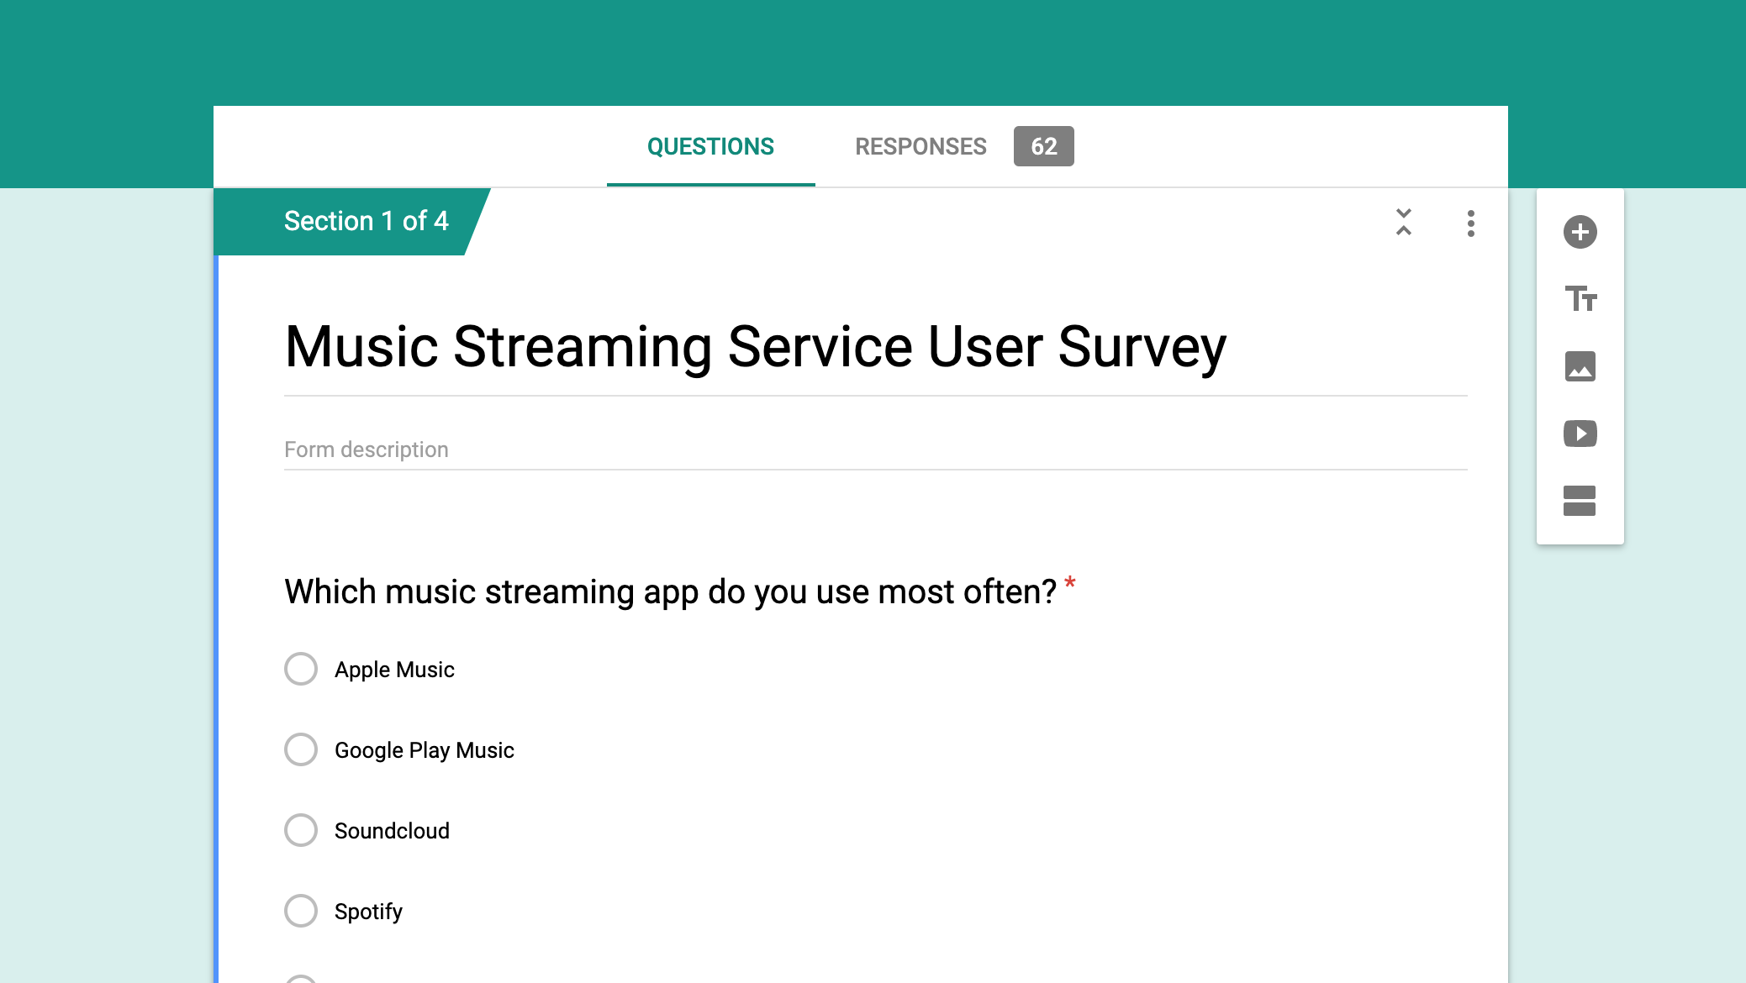

Slide 4
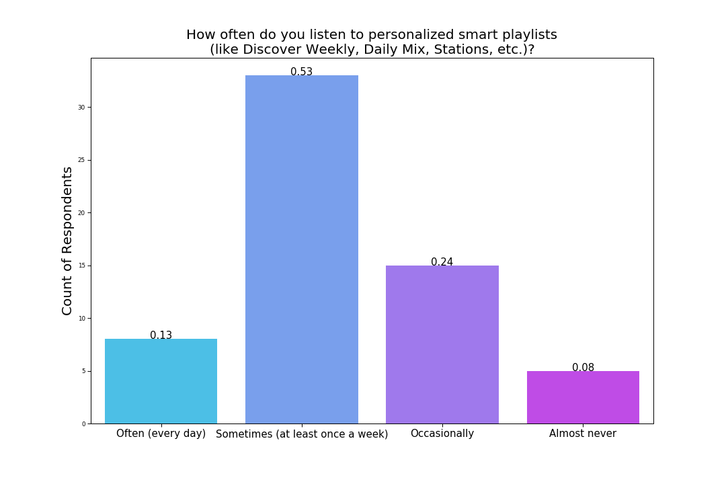

Slide 5
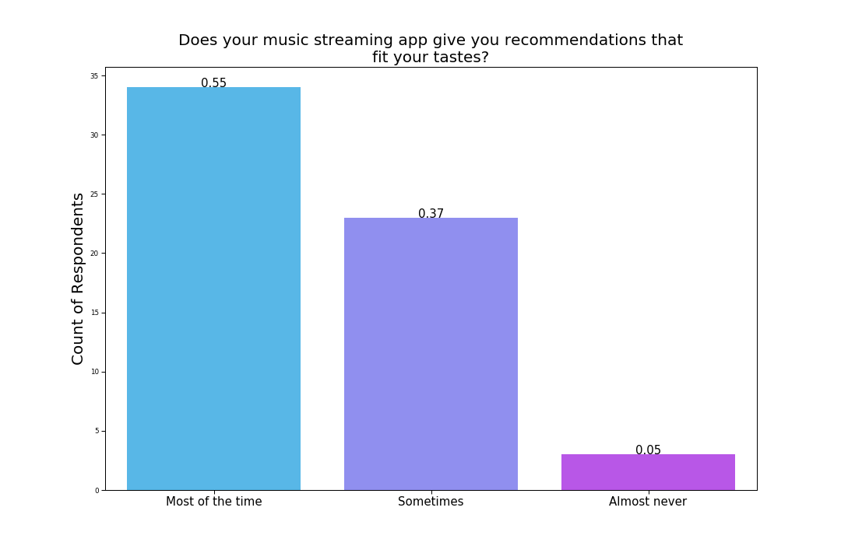

Slide 6
Pandora is better for "radio" stations in discovering new songs and hearing songs similar to what I like, also it is free. Spotify is better for finding and setting up music that I know I like and want to hear.

Slide 7
I often feel like the music recommended to me consists of stuff I’ve heard before (especially artists) and the premade playlists don’t really deviate into any eclectic or cool sounds, so i’m always listening to the same stuff.

Slide 8

Problem Statement
Music recommendation algorithms still struggle to achieve the “serendipity” factor that most users crave. These same algorithms are also biased toward established artists, which can add to the perceived monotony.

Slide 9
Project
Goal
To create a recommendation engine that takes songs from established artists who fit a given user's taste, match them with those from emerging artists via spectrogram analysis, and offer songs from the emerging artists as recommendations to the user.

Slide 10



Data Acquisition

Slide 11
Hot
Artists 100
Emerging 50
Billboard

Slide 12
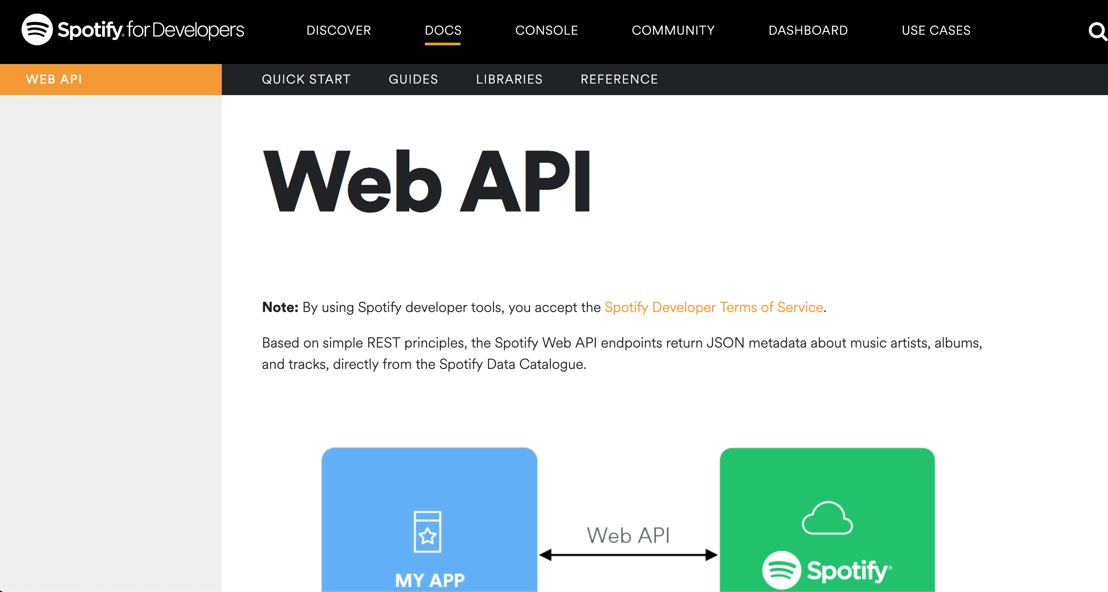

Slide 13
~8,500
songs

Slide 14
Audio Manipulation
mp3
waveform
spectrogram

Slide 15
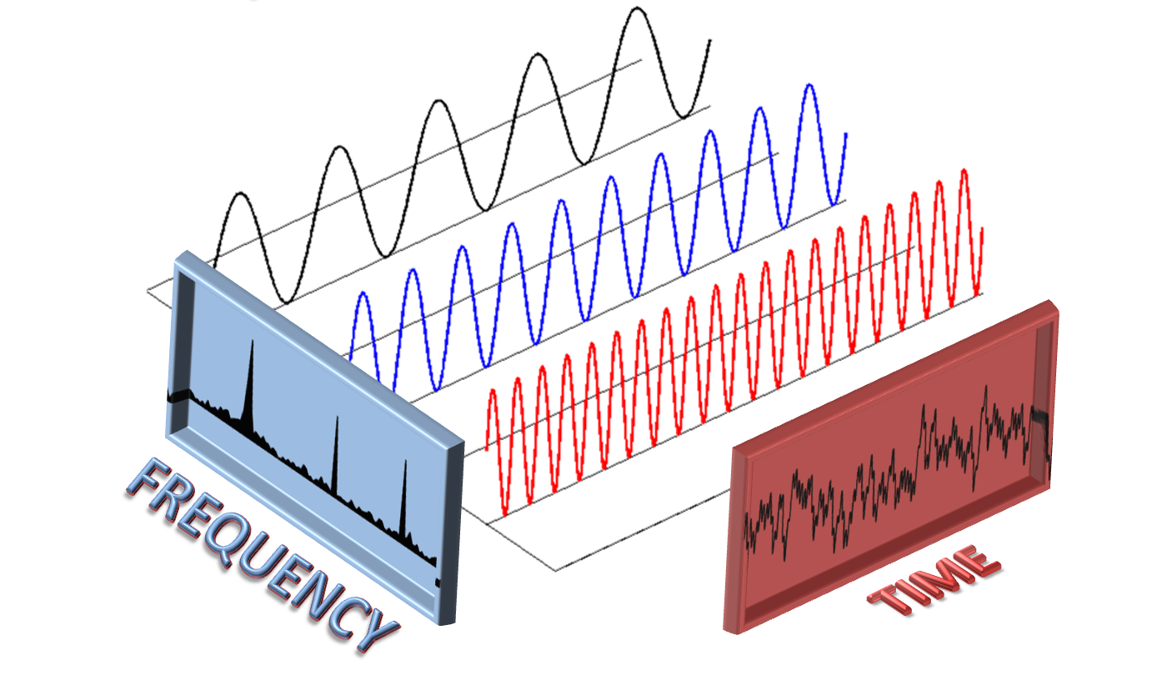
Fourier Transform

Slide 16
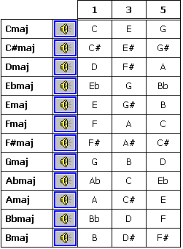
Kind of like...

Slide 17
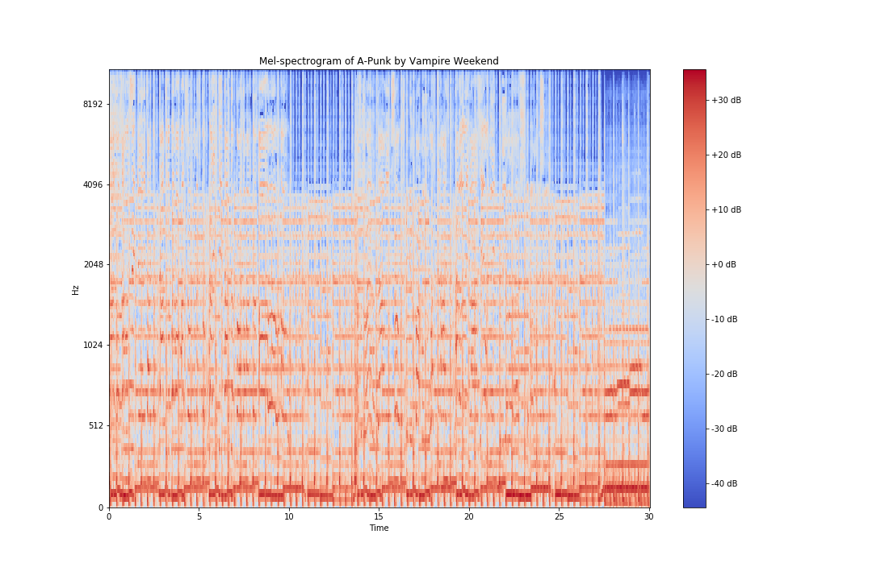

Slide 18


Slide 19
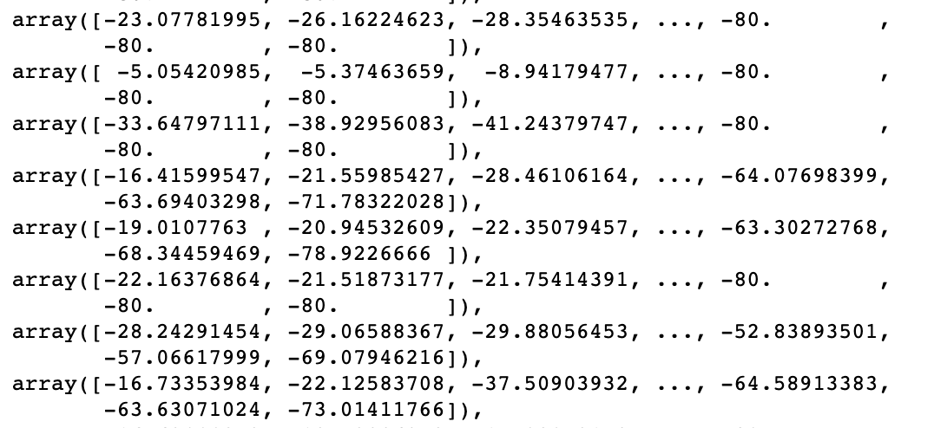
Each array was reshaped:
128 x 1294 → 1 x 165632

Slide 21
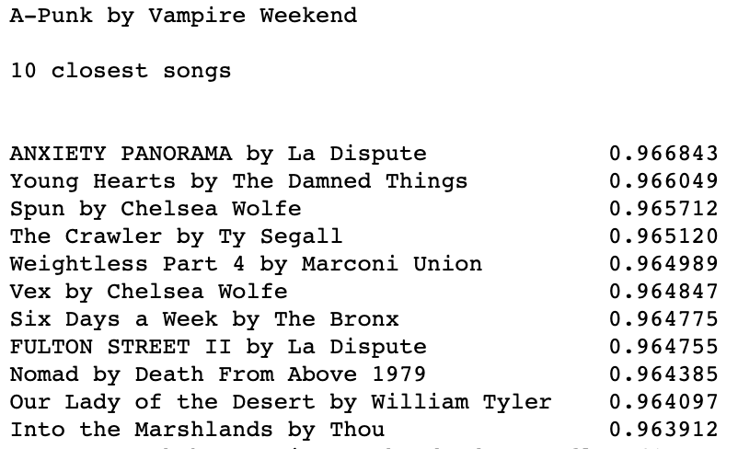

Slide 23
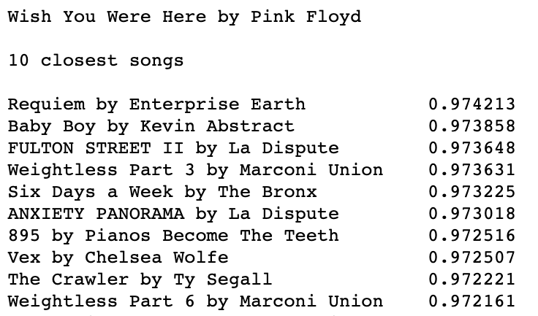

Slide 25
Future
Work
Introduce song metadata into the model.
Complete NLP analysis of Youtube comments and song lyrics
Introduce a neural network

Slide 26

THANKS!
Any questions?
You can find me at @jonruizruiz & github.com/jon-ruiz

Slide 27
CREDITS
Presentation template by SlidesCarnival
Advising by Bethany Poulin

